Slide 1

Logistic Regression
A Classification Technique

Slide 2
What is Logistic Regression? Why not linear?
Say that an unknown patient’s illness in the ER has been narrowed down to three possible causes:
1) Drug Overdose
2) Siezure
3) Stroke
Now we need to know which of these causes is most likely. So, our Y here is qualitative as we need the result to be either Y = {Drug Overdose (1) or Seizure (2) or Stroke(3)}
If we were to plug this into the LinearRegression() model, the first problem is that our output values would not be in the range 1-3, we would get values more extreme. Therefore our results, would not have any meaningful interpretation.
Consider the problem of predicting default rates of customers given their account balance. This is a binary problem Y= {Default|Not-default}

Slide 3
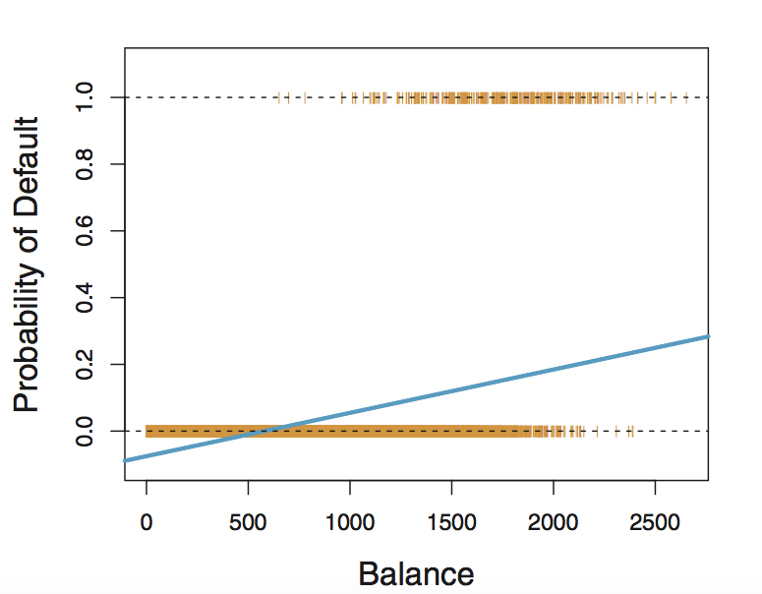
Linear Regression Modelling Probability

Slide 4
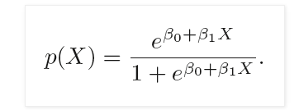
Introducing Logistic Regression
So, one thing we know is that we need to fit such a line that will be in the interval {0,1}.
What the logistic regression does is setup the problem like this:
Y = {0:Not-default X = {B₁ :Income
1: Default } B₂: Balance}
Then the task is to model the probability of default so we have
P(Default = Yes|Income) and P(Default= Yes|Balance)
So, P(Default = Yes|Income) = P(X) = B₀ + B_{balance} X

Slide 5
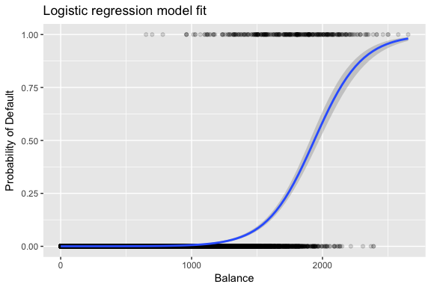
Introducing Logistic Regression
That particular specification produces a Sigmoid or S-shaped line.

Slide 6

Introducing Logistic Regression
To make our equation more interpretable, we can divide both sides of the logistic equation by 1-P(X) and then take the natural log. This gives,
Now our output values are probabilities in the interval of {0,1}
So if we create a probability threshold where P(X) > 0.5 = Default and P(X) < 0.5 = Not-default. Now, our results are interpretable!
What about interpreting our beta’s ? Well since our line is non-linear the interpretation is not straightforward but fundamentally still, an a positive coefficient for Income implies that an income increase the probability of default increases as well.

Slide 7
Remember!
Logistic regression does not predict a class in itself, but the probability that something belong to a particular class.
The probability threshold is not always 0.5. This is often a business decision. For example, a Bank may want to be very sure of default and may have a threshold of 0.2. So only if a customer is less than 20% likely to default is a loan extended.
Logistic regression does not do too well for multi-class classification. While it is possible, the results are not very stable.

Slide 10
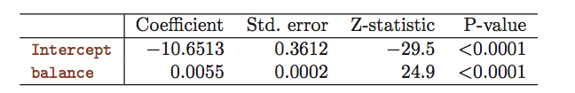
Logistic Regression Interpretation

Slide 11

If balance is $1000 then...
X(i) input

